Slide 1
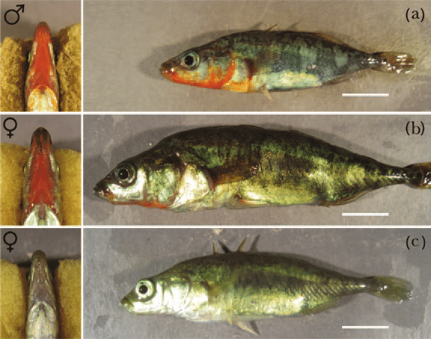
Practical Computing
Chloe Brown
MS Biology McKinnon Lab
East Carolina University

Slide 2
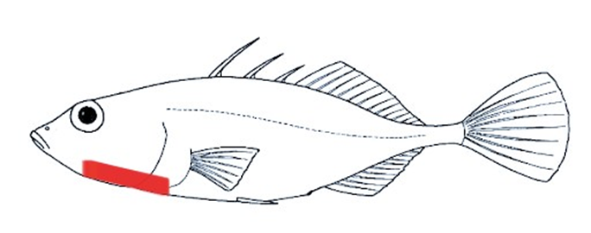
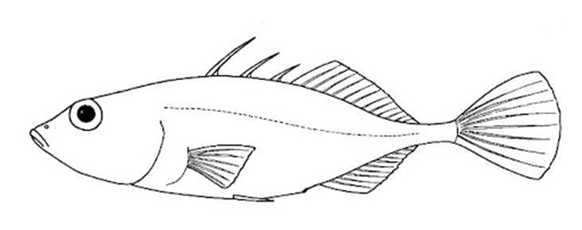
Thesis
Reduced sexual dimorphism across populations
Further investigate the evolutionary mechanisms and genetic basis of female conspicuous throat coloration
Discovering if females exhibiting orange-red throats are masculinized in other way across the genome
Determine if the same genomic regions across sexes contribute to orange-red throat coloration and the genetic mechanisms associated with them.
Genome Wide Association Study

Slide 3
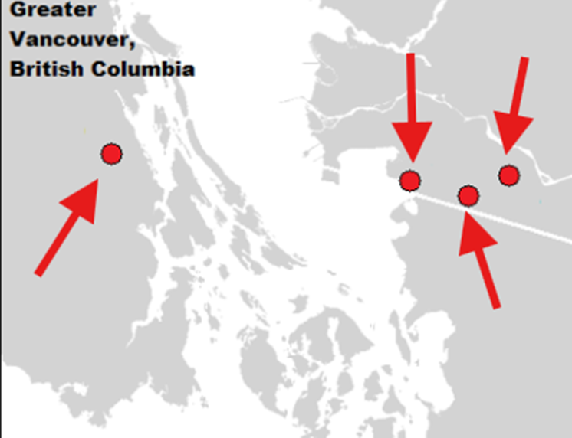



Raw Reads
DNA was extracted from Canadian stickleback
150 raw reads
Forward and reverse reads
Segmented pieces
Bonsall Creek Freshwater

Slide 4
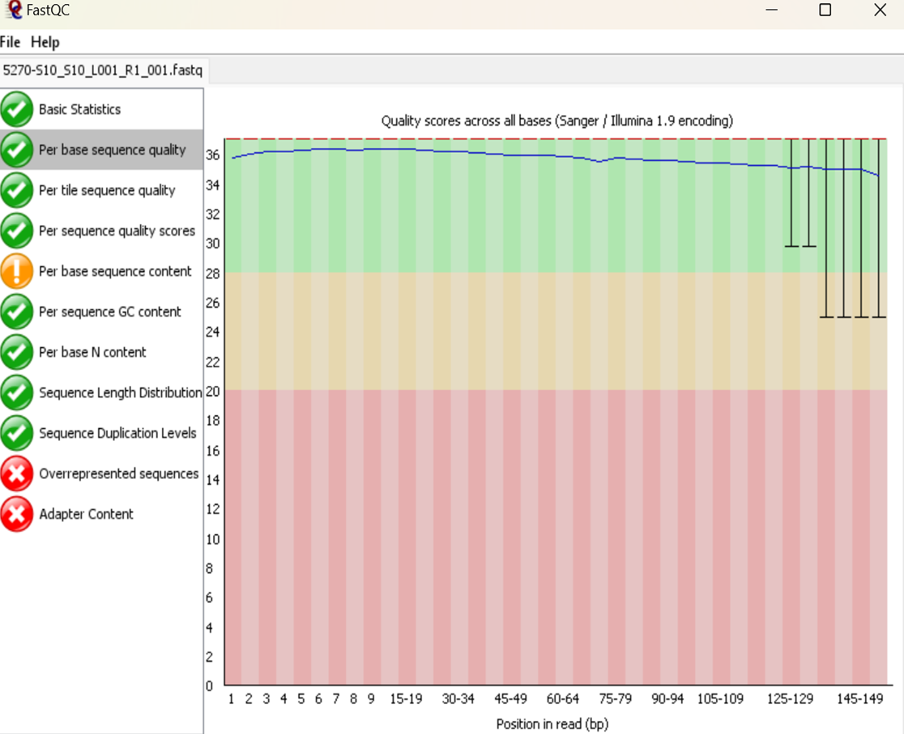
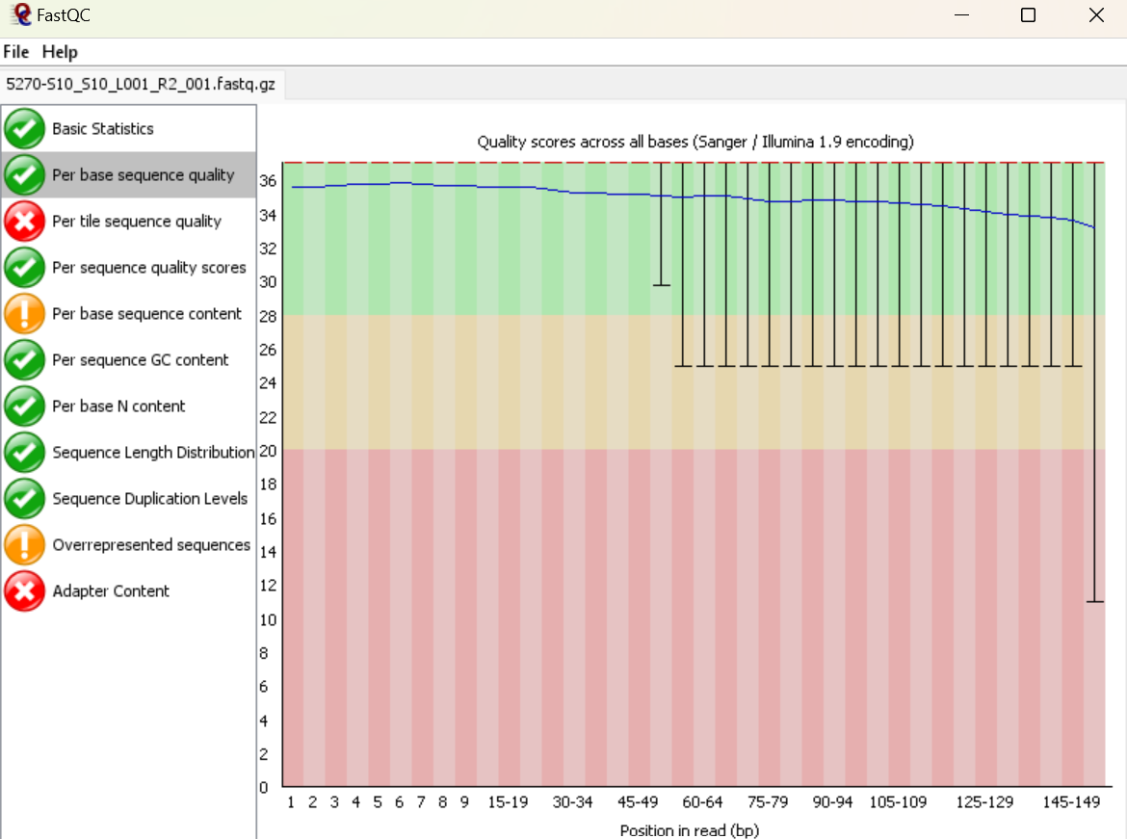
Run FastQC on Raw Reads
R1
Forward read
R2
Reverse read
Notes:
Look at both R1 and R2 aka forward and reverse reads
Recognize and remember the scoring of red and yellow.
For the per base sequence quality determine when the quality score goes below the 20 threshold
Its common for the reverse read to have more impurities

Slide 5
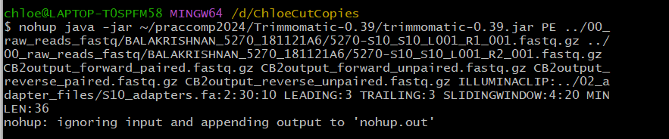
Trimmomatic-0.39

Slide 6

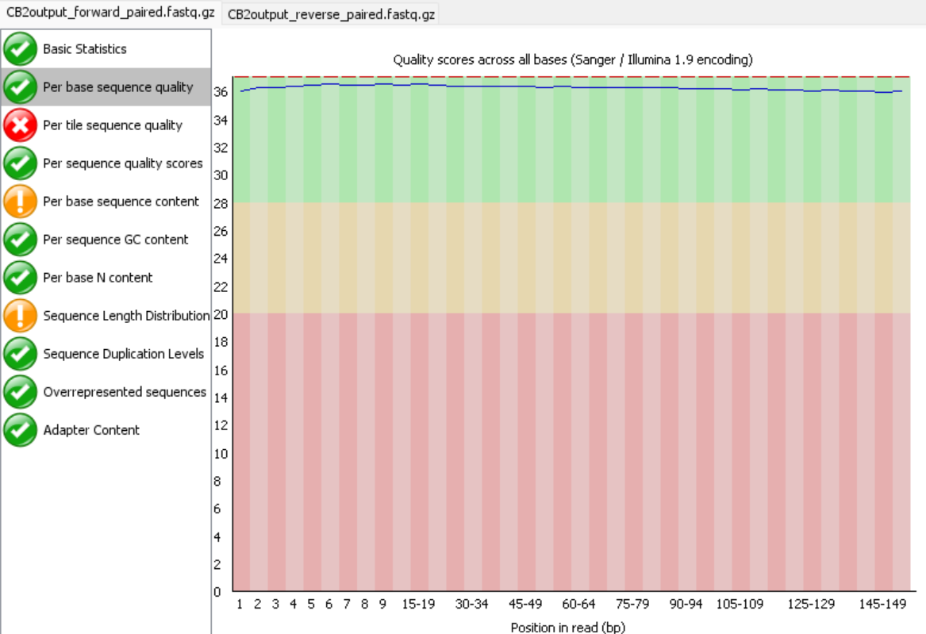
New Trimmed FastQC : Forward Reads
R1 Raw read R1 Trimmed paired read
Notes:
Review and compare scores of trimmed and untrimmed reads to ensure the remaining sequences are of high value and can continue to be used.

Slide 7

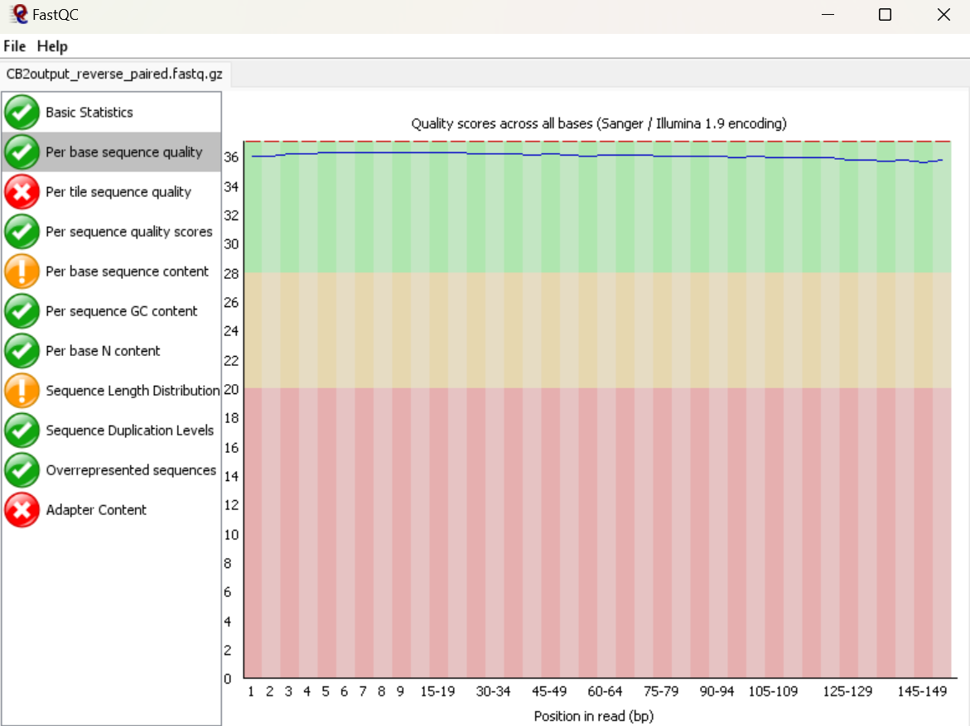
New Trimmed FastQC : Reverse Reads
R2 Raw read R2 Trimmed paired read
Notes:
Review and compare scores of trimmed and untrimmed reads to ensure the remaining sequences are of high value and can continue to be used.

Slide 8
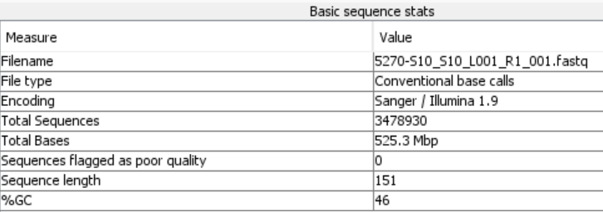
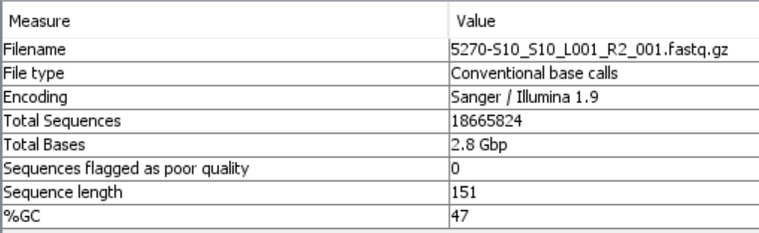
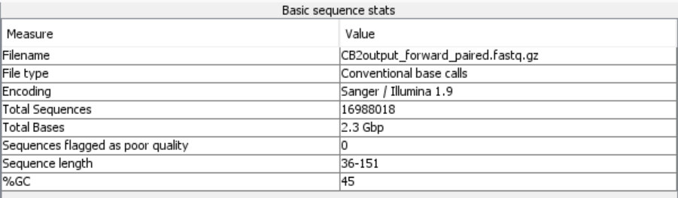
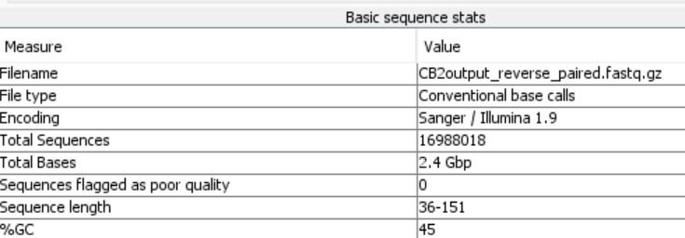
Before and After Trimming
Raw Forward Read Raw Reverse Reads
Trimmed Forward Reads Trimmed Reverse Reads

